Slide 1
Machine Learning
Machine Learning
Lecturer: Engr. Muhammad Ismail
CS Department Sukkur IBA University
Undergraduate (Fall 2026)
Semester: V

Slide 2
Arthur Lee Samuel (1901–July 29, 1990)
  a pioneer in artificial intelligence
    earliest machine learning programs
      through his work on a
        self-improving checkers-playing system at IBM.
  He called it:
    “The field of study that gives computers the ability to learn without being explicitly programmed.”
  As programmers,
    we often approach problems in a methodical, logic-based way.
      We try to determine what our desired outputs should be, and
        then create the proper rules that will transform our inputs into those outputs.
  Machine learning flips the script.
    We want the program itself to learn the rules that
      describe our data the best, by
        finding patterns in what we know and applying those patterns to what we don’t know.

Slide 3
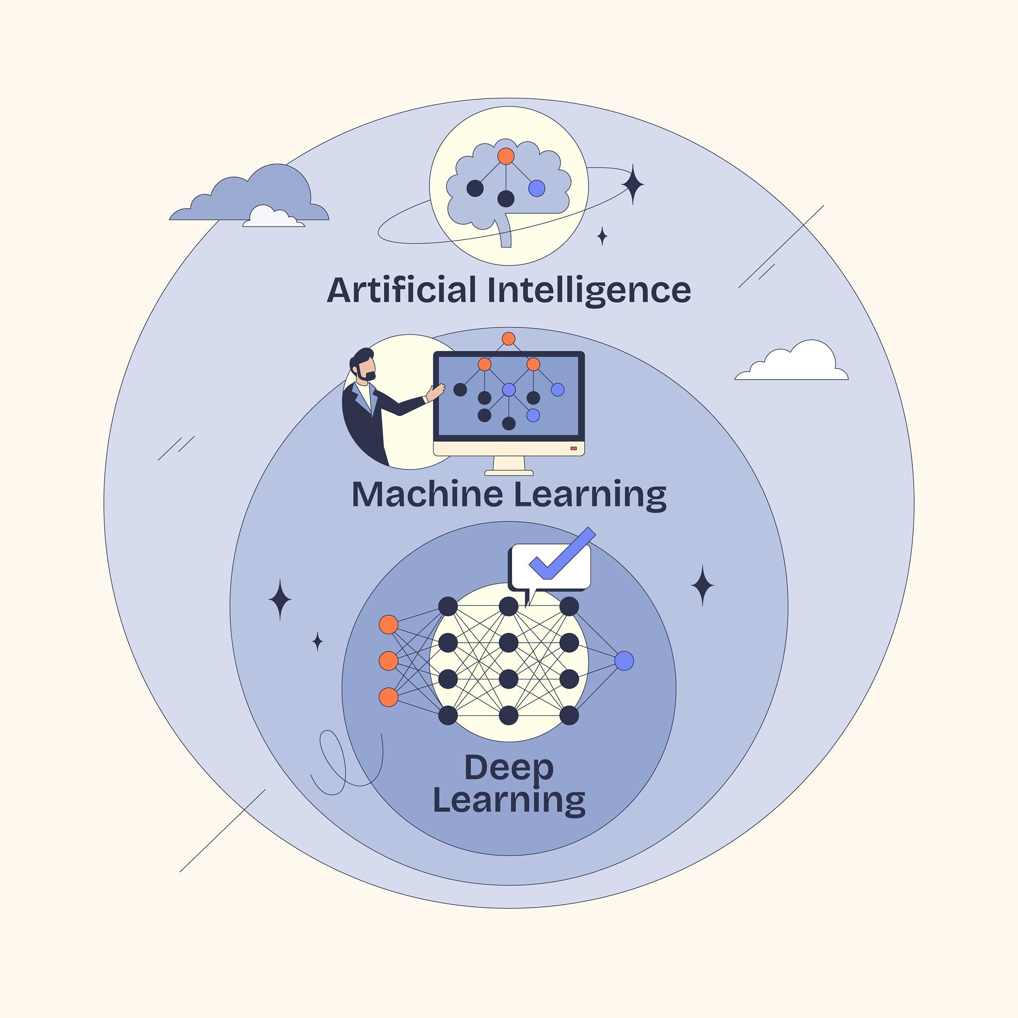
These algorithms are
  able to learn.
    Their performance gets better and better with
      each iteration, as it uncovers more hidden trends in the data
What is Machine Learning
  Machine Learning (ML) is a branch of Artificial Intelligence (AI)
    focused on building systems that
    learn from data to make predictions or decisions
      without being explicitly programmed.

Slide 4
Core Learning Paradigms
  Supervised Learning:
    The model trains on labeled data (input-output pairs). It learns a mapping function to predict labels for new inputs (e.g., linear regression, decision trees, support vector machines). Common tasks include classification and regression.
  Unsupervised Learning:
    The model receives unlabeled data and looks for inherent structure, clusters, or patterns (e.g., K-Means clustering, PCA, autoencoders).
  Reinforcement Learning:
    An agent learns by interacting with an environment, receiving rewards for desirable actions and penalties for errors (e.g., Q-learning, Policy Gradients).
  Semi-Supervised / Self-Supervised Learning:
    Combines a small amount of labeled data with a large body of unlabeled data to improve learning accuracy or learn representations directly from data structure (e.g., masked language models in NLP).

Slide 5
The Standard ML Pipeline
  Data Collection & Preprocessing:
    Gathering raw data, cleaning missing values, and handling outliers.
  Feature Engineering & Extraction:
    Transforming raw data into informative representations (scaling, encoding categorical values, or feature selection).
  Model Selection & Training:
    Choosing an algorithm suitable for the task and optimizing its parameters using training data (e.g., minimizing a loss function via gradient descent).
  Evaluation:
    Measuring model generalization on an unseen test set using metrics like Accuracy, Precision/Recall, F1-Score, or Mean Squared Error (MSE) to check for overfitting or underfitting.
  Deployment & Monitoring:
    Integrating the trained model into production and monitoring performance over time for data or concept drift.

Slide 6
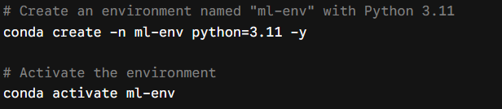
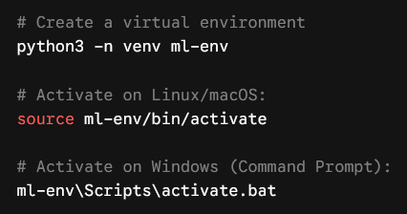
Python setup for Machine Learning
  Set Up a Virtual Environment
    Option A: Using conda (Recommended for ML/Data Science)
    Option B: Using standard venv

Slide 7
Core Library Stack
Category | Primary Libraries | Installation Command
Data & Math | NumPy, Pandas, SciPy | pip install numpy pandas scipy
Visualization | Matplotlib, Seaborn | pip install matplotlib seaborn
Classical ML | Scikit-Learn | pip install scikit-learn
Interactivity | JupyterLab, Notebook | pip install jupyterlab
Deep Learning (Choose based on needs) | PyTorch or TensorFlow | pip install torch torchvision pip install tensorflow

Slide 8
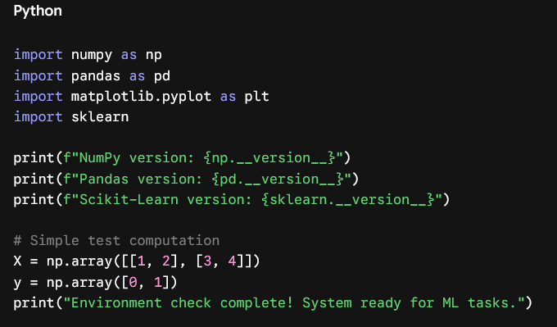
To install the core traditional ML stack in one command:
Verification Script

Slide 9
Machine Learning
  Giving Computers the Ability to Learn from Data
  Building intelligent machines to transform data into knowledge
  one resource that we have in abundance:
    a large amount of structured and unstructured data.
  machine learning evolved
    as a subfield of artificial intelligence (AI) involving
      self-learning algorithms that
        derive knowledge from data in order to make predictions.
  machine learning offers a more efficient
    alternative for capturing the knowledge in data to gradually improve the
      performance of predictive models and make data-driven decisions.
  machine learning
    we enjoy robust email spam filters, convenient text and voice
      recognition software, reliable web search engines, and challenging chess-playing programs.

Slide 10
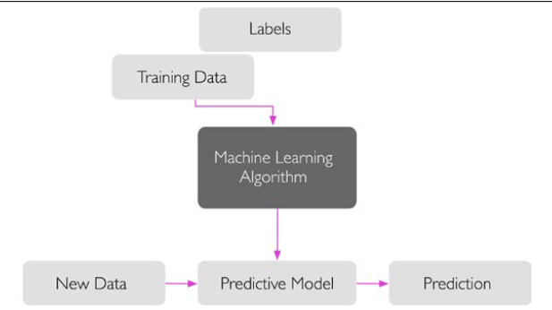
The three different types of machine Learning
  Supervised learning,
  unsupervised learning, and
  reinforcement learning
Making predictions about the future with supervised learning
  main goal in supervised learning
    learn a model from labeled training
    data that allows us to make
    predictions about unseen or
    future data.

Slide 11
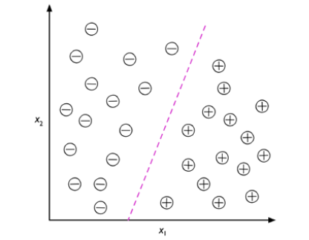
Classification for predicting class labels
  Predict
    the categorical class labels of new instances, based on past observations.

Slide 12
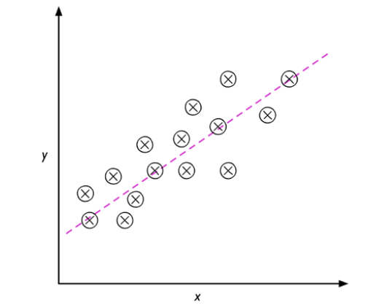
Regression for predicting continuous outcomes
  A second type of supervised learning
    is the prediction of continuous outcomes, which is also called regression analysis
    given a number of predictor (explanatory) variables and
      a continuous response variable (outcome), and we try to find a relationship between
      those variables that allows us to predict an outcome.

Slide 13
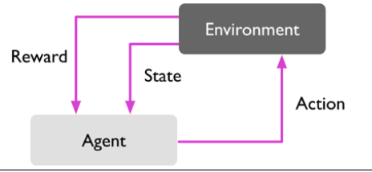
Solving interactive problems with reinforcement learning
  Reinforcement Learning (RL) frames
    interactive problems as
      a continuous feedback loop where
      an agent observes a state,
      takes an action,
      receives a reward, and
      transitions to a new state.

Slide 14
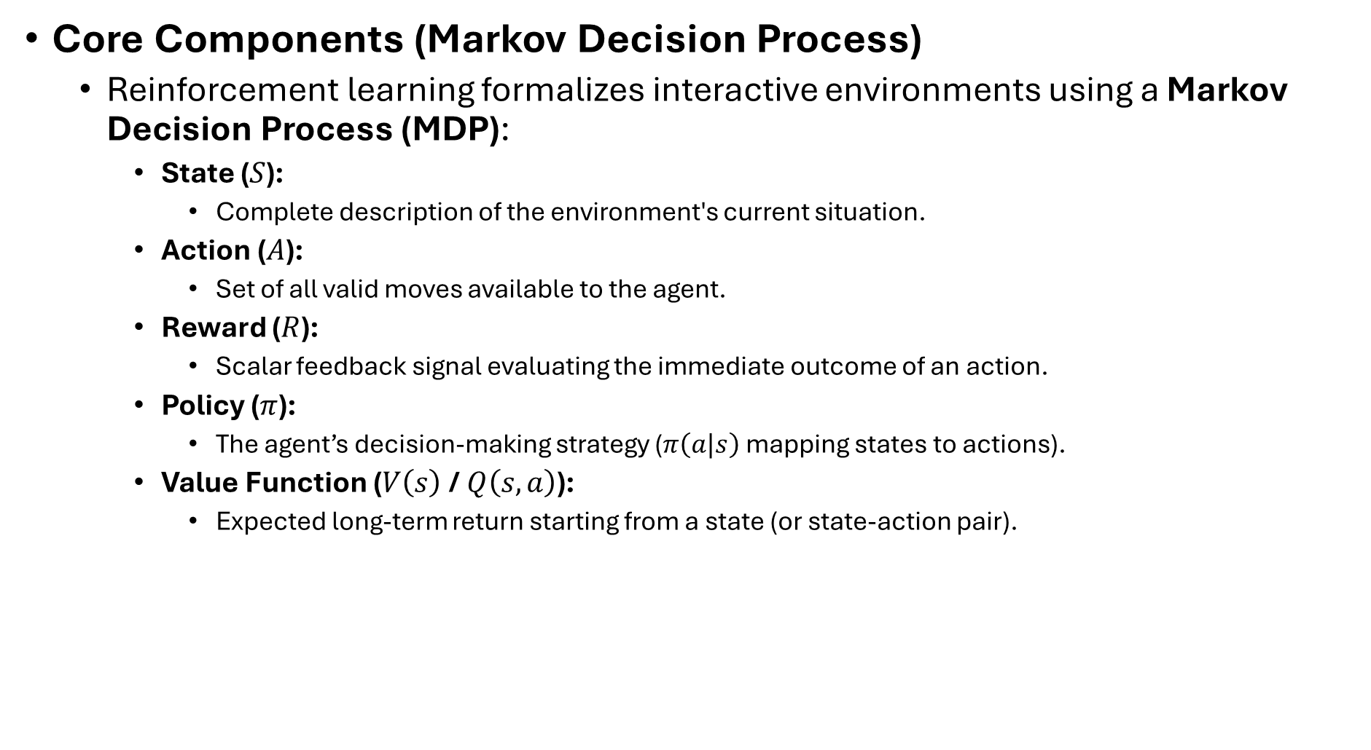
Core Components (Markov Decision Process)
  Reinforcement learning formalizes interactive environments using a Markov Decision Process (MDP):
    State ($S$):
      Complete description of the environment's current situation.
    Action ($A$):
      Set of all valid moves available to the agent.
    Reward ($R$):
      Scalar feedback signal evaluating the immediate outcome of an action.
    Policy ($π$):
      The agent’s decision-making strategy ($π\left(a|s\right)$ mapping states to actions).
    Value Function ($V\left(s\right)$ / $Q\left(s,a\right)$):
      Expected long-term return starting from a state (or state-action pair).

Slide 15
In unsupervised learning,
  there is no answer key
    the model has to decide what's interesting or meaningful about the data by itself,
      usually by exploiting statistical regularities:
        which points look similar, which dimensions carry the most variation, which combinations of features tend to co-occur
  Main families of techniques
    Clustering — grouping similar data points together.
      K-means:
        partitions data into k groups by minimizing distance to group centers.
      Hierarchical clustering:
        builds a tree of nested clusters, useful when you don't know k in advance.
      DBSCAN:
        finds clusters of arbitrary shape based on density, and naturally identifies outliers.
        DBSCAN (Density-Based Spatial Clustering of Applications with Noise)
          is a popular unsupervised machine learning algorithm. It groups data points based on how closely packed they are, finding clusters of any shape while marking sparse points as noise or outliers.

Slide 16
Main families of techniques
  Dimensionality reduction — compressing data into fewer dimensions while preserving structure.
    PCA (Principal Component Analysis):
      finds the directions of greatest variance in the data.
    t-SNE / UMAP:
      nonlinear techniques good for visualizing high-dimensional data in 2D or 3D.
    Autoencoders:
      neural networks that learn a compressed "bottleneck" representation of the data.
  Association rule learning — finding relationships between variables, like "customers who buy bread often buy butter too" (classic market-basket analysis).
  Anomaly detection — identifying data points that don't fit the learned structure, used for fraud detection, network intrusion detection, or manufacturing defect spotting.

Slide 17
Unsupervised learning
  is what you reach for when labeling data is expensive, impossible, or the point is discovery rather than prediction.
  It powers:
    Customer segmentation
      in marketing (grouping users by behavior without predefined categories)
    Recommendation systems
      (finding latent structure in what people like)
    Genomics
      (clustering gene expression patterns)
    Exploratory data analysis
      (understanding a new dataset before deciding what to model)
    Pretraining for other models
      (learned representations often feed into downstream supervised tasks)
  The core challenge
    Because there's no ground truth, evaluating an unsupervised model is harder

Slide 18
Dimensionality reduction for data compression
  Dimensionality reduction takes
    data with many features (dimensions) and
      represents it with far fewer,
      while preserving as much of the meaningful structure as possible.
      as compression
    Why "compression" is the right lens
    PCA (Principal Component Analysis)
      the classic linear approach
      It finds the directions (called principal components) along which the data varies the most, and ranks them by how much variance they explain.
      If you keep only the top 2 or 3 components out of the original hundreds, you've compressed the data while retaining most of its "spread" — the components that mattered least (often close to noise) get dropped.
      Strength:
        fast, interpretable, deterministic, well understood mathematically.
      Limitation:
        it only captures linear relationships — if your data lies on a curved manifold, PCA will miss that structure.

Slide 19
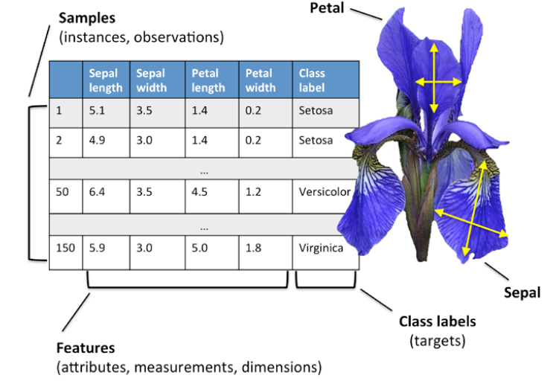
Notation and conventions used in this book

Slide 20
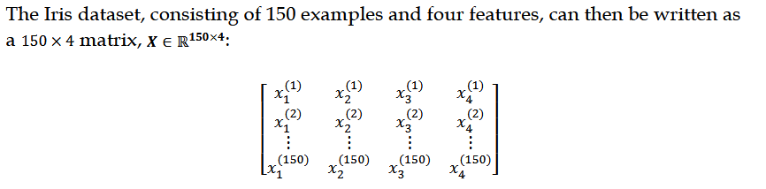
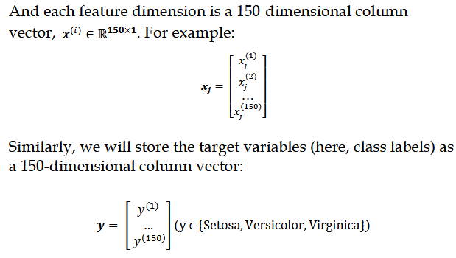
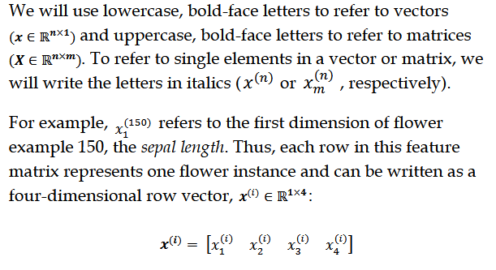
Notational conventions

Slide 21
Machine learning terminology
  Training example: A row in a table representing the dataset and synonymous
    with an observation, record, instance, or sample (in most contexts, sample
    refers to a collection of training examples).
  Training:
    Model fitting, for parametric models similar to parameter
      estimation.
  Feature, abbrev. x:
    A column in a data table or data (design) matrix.
      Synonymous with predictor, variable, input, attribute, or covariate.
  Target, abbrev. y:
    Synonymous with outcome, output, response variable,
      dependent variable, (class) label, and ground truth.
  Loss function:
    Often used synonymously with a cost function. Sometimes
      the loss function is also called an error function. In some literature, the
      term "loss" refers to the loss measured for a single data point, and the cost
      is a measurement that computes the loss (average or summed) over the
        entire dataset.

Slide 22
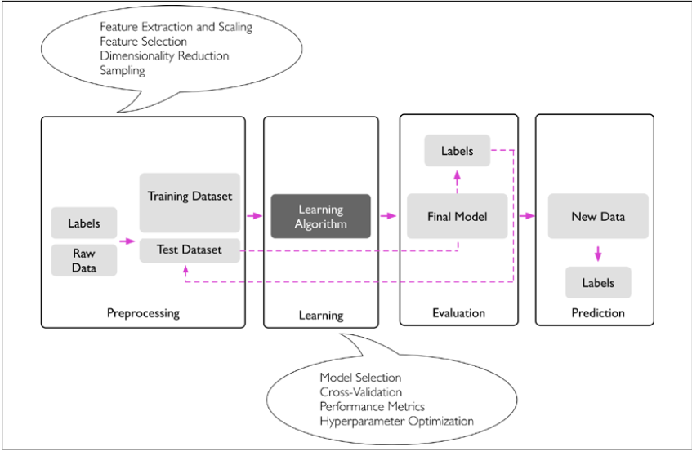
A roadmap for building machine learning systems

Slide 23
Preprocessing – getting data into shape

Slide 24
Artificial neurons
  Trying to understand how
      the biological brain works, in order to design artificial intelligence (AI), Warren
      McCulloch and Walter Pitts published the first concept of a simplified brain cell,
      the so-called McCulloch-Pitts (MCP) neuron, in 1943 (A Logical Calculus of the Ideas
      Immanent in Nervous Activity, W. S. McCulloch and W. Pitts, Bulletin of Mathematical
      Biophysics, 5(4): 115-133, 1943).
  Biological neurons are interconnected nerve cells
    in the brain that are involved in the processing and transmitting of chemical and
      electrical signals, which is illustrated in the following figure:

Slide 25
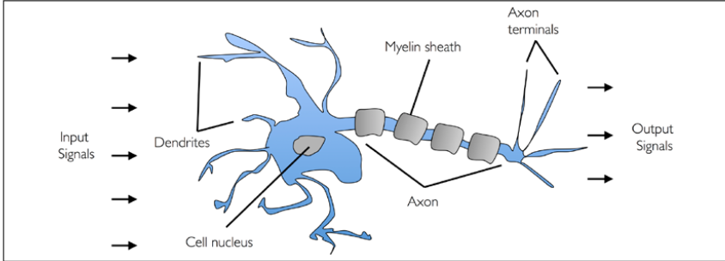
McCulloch and Pitts
  described such a nerve cell as a simple logic gate with binary
    outputs; multiple signals arrive at the dendrites, they are then integrated into the cell
    body, and, if the accumulated signal exceeds a certain threshold, an output signal is
    generated that will be passed on by the axon.

Slide 26
Only a few years later,
    Frank Rosenblatt published the first concept of the perceptron
      learning rule based on the MCP neuron model (The Perceptron: A Perceiving and
      Recognizing Automaton, F. Rosenblatt, Cornell Aeronautical Laboratory, 1957). With his
      perceptron rule, Rosenblatt proposed an algorithm that would automatically learn
      the optimal weight coefficients that would then be multiplied with the input features
      in order to make the decision of whether a neuron fires (transmits a signal) or not. In
      the context of supervised learning and classification, such an algorithm could then be
      used to predict whether a new data point belongs to one class or the other

Slide 27
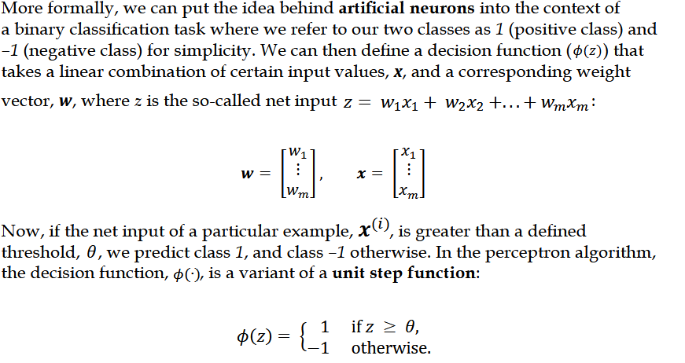
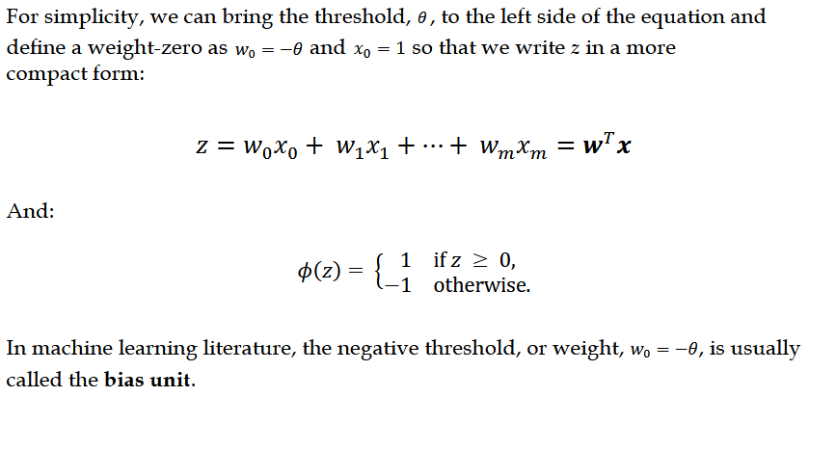
The formal definition of an artificial neuron

Slide 28
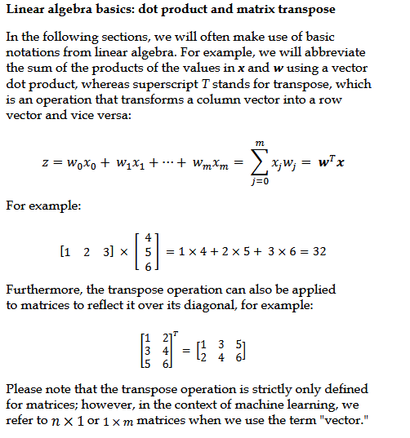

Slide 29

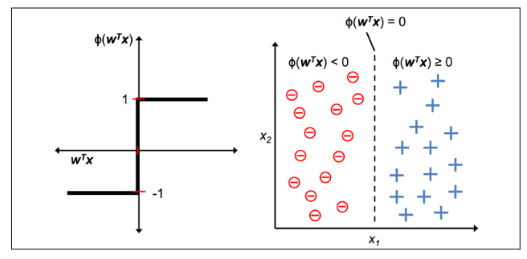

Slide 30
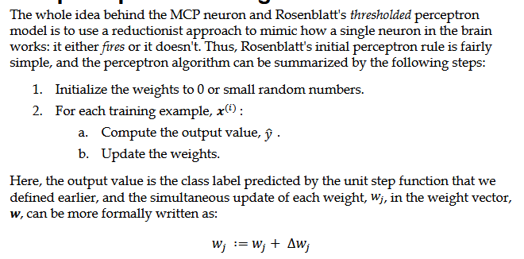
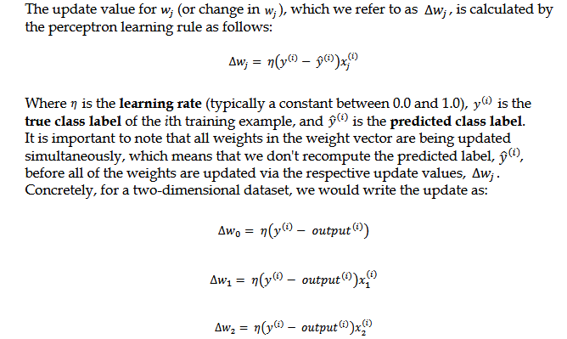
The perceptron learning rule

Slide 31
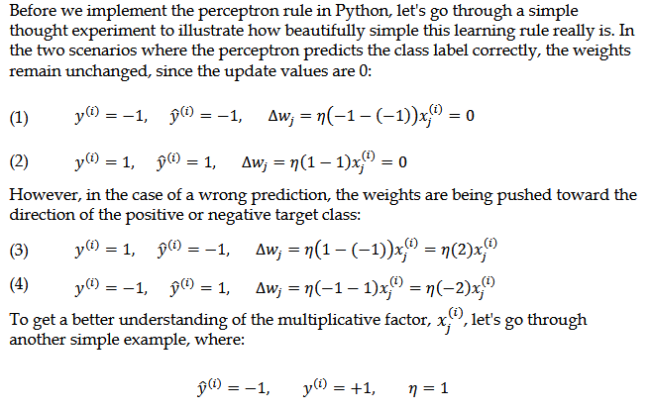
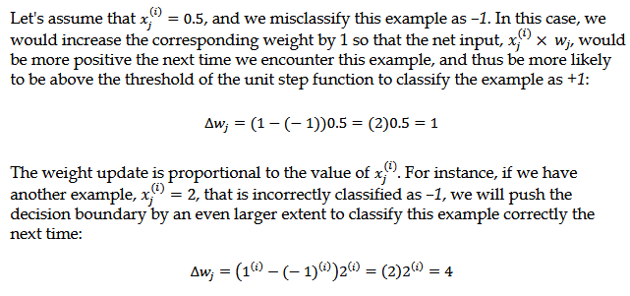

Slide 32
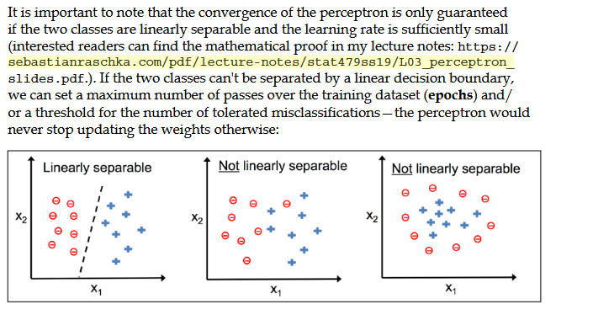

Slide 33
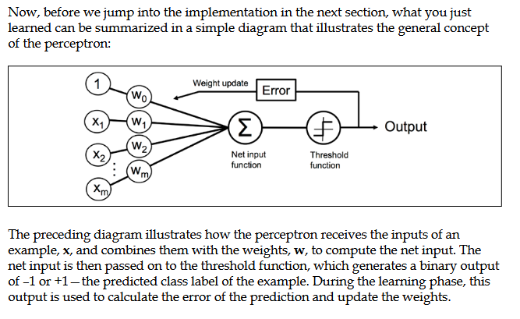

Slide 34
Interactive Mode
  python3.14
  Getting started with conda
    Open either the Anaconda or Miniforge Command Prompt (cmd.exe). A PowerShell prompt is also available with Anaconda Distribution or Miniconda.
    conda create --name <env-name>
    conda create --name myenvironment python numpy pandas
    conda info –envs
      conda environments:
      base /home/username/Anaconda3
      myenvironment * /home/username/Anaconda3/envs/myenvironment
  Installing packages
    # via environment activation
    conda activate myenvironment
    conda install matplotlib
    # via command line option
    conda install --name myenvironment matplotlib

Slide 35
Updating conda
  conda –version
  conda 26.5.3
  conda update conda
  & "C:\ProgramData\miniforge3\Scripts\conda.exe" init powershell

Slide 36
tree-based methods
  These involve stratifying or segmenting the predictor space into a
    number of simple regions
    Decision Trees (DTs) are a non-parametric supervised learning method used for classification and regression.
    The goal is to create a model that predicts the value of a target variable by learning simple decision rules inferred from the data features.
    Decision trees are versatile machine learning algorithms that can perform both classification and regression tasks, and even multioutput tasks.
  Regression Trees
    Predicting Baseball Players’ Salaries Using Regression Trees

Slide 37
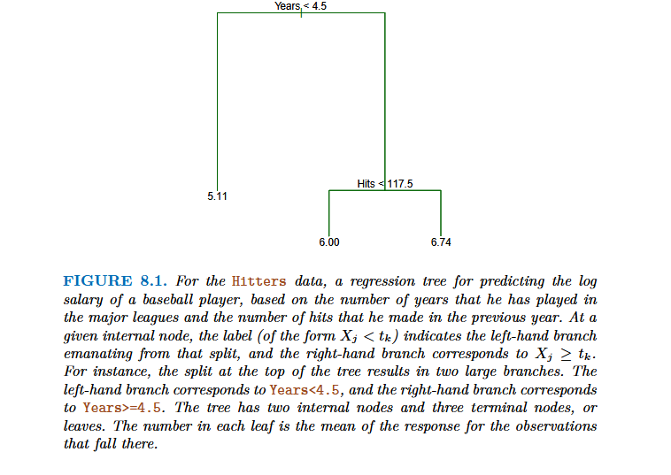

Slide 38
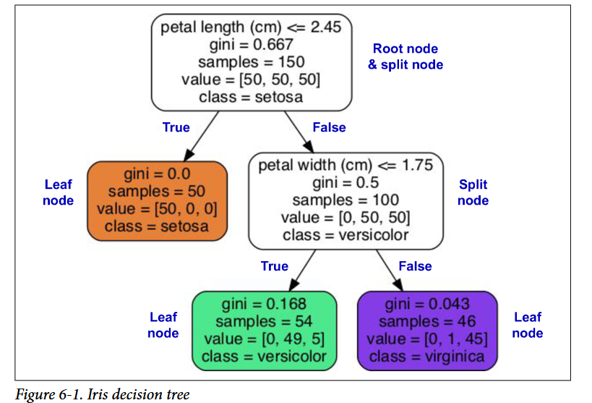
A decision tree is a hierarchical data structure implementing the
  divide-and-conquer strategy.

Slide 39
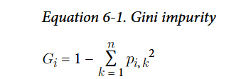
root node
leaf node
  it does not have any child nodes
split node
One of the many qualities of decision trees is that they require very
  little data preparation. In fact, they don’t require feature scaling or
    centering at all.
node’s samples attribute
node’s value attribute
Gini impurity:

Slide 40
Scikit-Learn uses the CART algorithm, which produces only binary
  trees, meaning trees where split nodes always have exactly two
    children (i.e., questions only have yes/no answers). However, other
      algorithms, such as ID3, can produce decision trees with nodes that
      have more than two children.
Decision tree’s decision boundaries

Slide 41
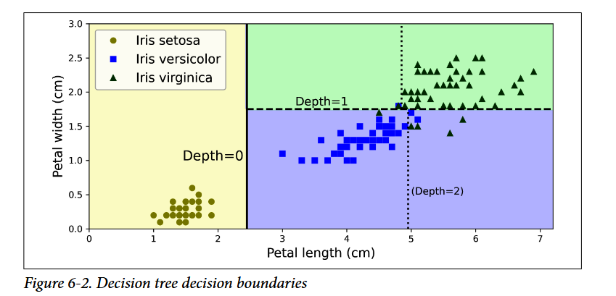

Slide 42
Model Interpretation:
  White Box Versus Black Box
    Decision trees are intuitive, and their decisions are easy to interpret. Such models are
      often called white box models.
  Discussion
Estimating Class Probabilities
  A decision tree can also estimate the probability that an instance belongs to a particular class k.
    First it traverses the tree to find the leaf node for this instance, and
    then it returns the ratio of training instances of class k in this node.

Slide 43
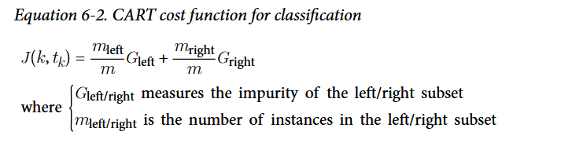
The CART Training Algorithm
  Classification and Regression Tree (CART)
  decision trees (also called “growing” trees)
    The algorithm works by first splitting
    the training set into two subsets using a single feature k and
      a threshold tk (e.g.,“petal length ≤ 2.45 cm”).
  Once the CART algorithm has successfully split the training set in two,
    it splits
    the subsets using the same logic, then the sub-subsets, and so on, recursively.

Slide 44
  stops recursing once it reaches the maximum depth (defined by the max_depth hyperparameter), or if it cannot find a split that will reduce impurity.
  the CART algorithm is a greedy algorithm
  finding the optimal tree is known to be an NP-complete problem.
  It requires O(exp(m)) time, making the problem intractable even for small training sets.
Computational Complexity
  Decision trees generally are approximately balanced
  traversing the decision tree,O(log2(m)) nodes
    P is the set of problems that can be solved in polynomial time (i.e., a polynomial of the dataset size). NP is
      the set of problems whose solutions can be verified in polynomial time. An NP-hard problem is a problem
      that can be reduced to a known NP-hard problem in polynomial time. An NP-complete problem is both NP
      and NP-hard. A major open mathematical question is whether or not P = NP. If P ≠ NP (which seems likely),
      then no polynomial algorithm will ever be found for any NP-complete problem (except perhaps one day on a
      quantum computer).

Slide 45
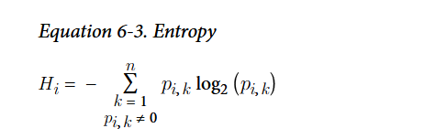
  since each node only requires checking the
    value of one feature, the overall prediction complexity is O(log2(m)), independent of
    the number of features. So predictions are very fast, even when dealing with large
    training sets.
  The training algorithm compares all features (or less if max_features is set) on all
    samples at each node. Comparing all features on all samples at each node results in a
    training complexity of O(n × m log2(m))
Gini Impurity or Entropy
  you can select the entropy impurity measure instead by setting the criterion hyper‐parameter to "entropy".
  The concept of entropy
    measure of disorder
    a mathematical measure of randomness, uncertainty, or impurity in a dataset
  In machine learning, entropy is frequently used as an impurity measure:
    a set’s entropy is zero when
    it contains instances of only one class.

Slide 46
High Entropy: The data is completely mixed and unpredictable. For example, a bag with 50 red balls and 50 blue balls has high entropy because you cannot guess the color of a randomly picked ball.
Low Entropy: The data is clean, orderly, and predictable. For example, a bag with 99 red balls and 1 blue ball has low entropy because you can safely guess the color will be red.

Slide 47
Gini impurity is slightly faster to
  compute, so it is a good default.
Gini impurity tends to
  isolate the most frequent class in its own branch of the tree, while entropy tends to
    produce slightly more balanced trees.
Regularization Hyperparameters
  Decision trees make very few assumptions about the training data (as opposed to linear models, which assume that the data is linear, for example).
  If,Left,Unconstrained
  Overfitting
    And,noisy data
  nonparametric model,
  parametric model
  degree of freedom
    limited, unlimited

Slide 48
To avoid overfitting
  the training data, you need to restrict the decision tree’s freedom
    during training.
    Called regularization.
  DecisionTreeClassifier
    max_features
    max_leaf_nodes
    min_samples_split
    min_samples_leaf
    min_weight_fraction_leaf

Slide 49
Pruning
  Other algorithms work by first training the decision tree without
    restrictions, then pruning (deleting) unnecessary nodes.
    A node
      whose children are all leaf nodes is considered unnecessary if
      the purity improvement it provides is not statistically significant.
      Standard statistical tests, such as the χ2 test (chi-squared test), are
      used to estimate the probability that the improvement is purely
      the result of chance (which is called the null hypothesis). If this
      probability, called the p-value, is higher than a given threshold
      (typically 5%, controlled by a hyperparameter), then the node is
      considered unnecessary and its children are deleted. The pruning
      continues until all unnecessary nodes have been pruned.

Slide 50
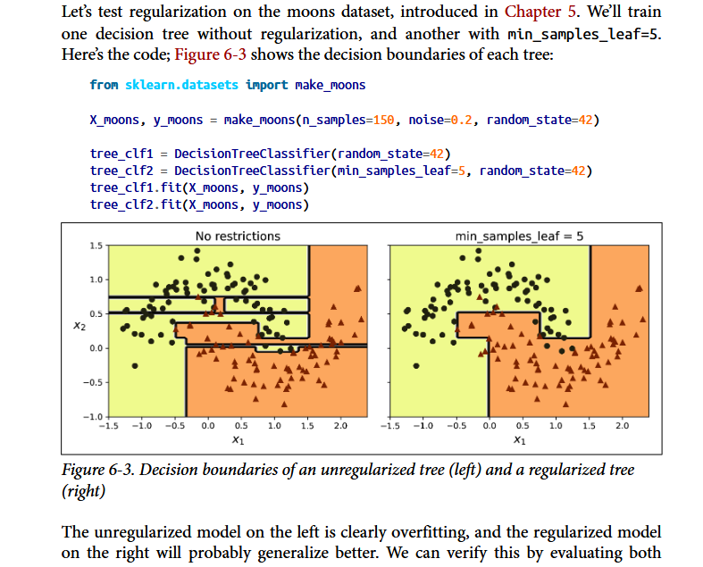

Slide 51
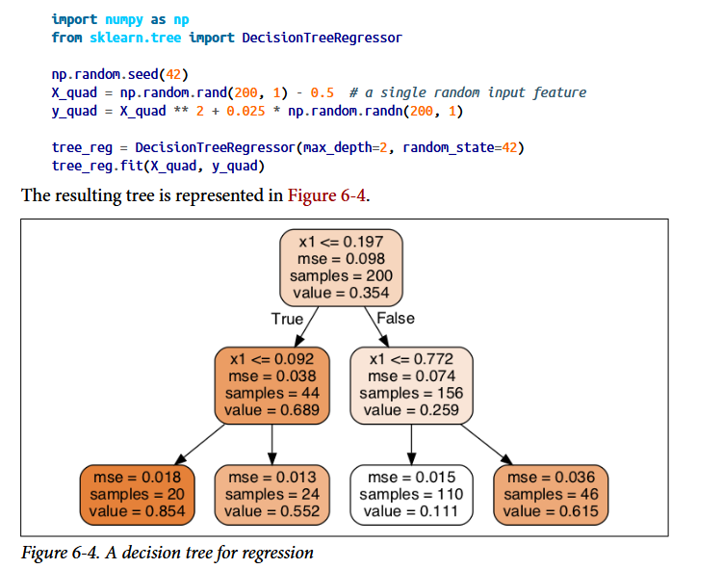
Regression

Slide 52
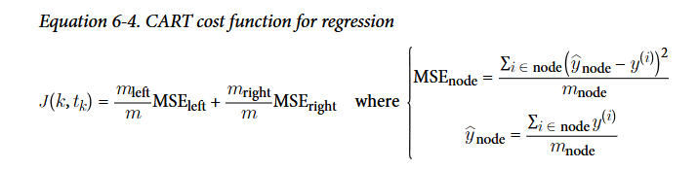
The CART algorithm
  instead of trying to split
  the training set in a way that minimizes impurity, it now tries to split the training
  set in a way that minimizes the MSE

Slide 53
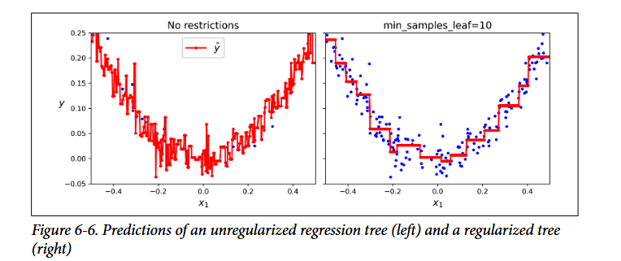
regularization

Slide 54
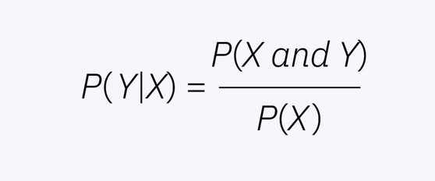
Naive Bayes' Theorem
  a supervised machine learning algorithm
  used for classification tasks such as text classification
  use principles of probability to perform classification tasks
  part of a family of generative learning algorithms
  also known as a probabilistic classifier
  conditional probabilities
  use of sequential events
  additional information later acquired
    impacts the initial probability
  predictors in a Naïve Bayes model are
    conditionally independent, or unrelated to any of the other feature in the model.
  It also assumes that all features contribute equally to the outcome.

Slide 55
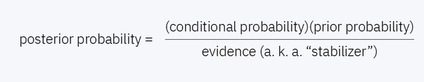
While these assumptions are often violated in real-world scenarios
  (e.g. a subsequent word in an e-mail is dependent upon the word that precedes it),
  it simplifies a classification problem by making it more computationally tractable.
  That is, only a single probability will now be required for each variable,
  which, in turn, makes the model computation easier.
  Despite this unrealistic independence assumption,
    the classification algorithm performs well,
    particularly with small sample sizes.

Slide 56

Example
    imagine there is an individual, named Jane, who takes a test to determine if she has diabetes. Let’s say that the overall probability having diabetes is 5%; this would be our prior probability. However, if she obtains a positive result from her test, the prior probability is updated to account for this additional information, and it then becomes our posterior probability. This example can be represented with the following equation, using Bayes’ Theorem:

Slide 57

Bayes' Theorem
  conditional probability by updating the likelihood of an event as more evidence or information becomes available
  P(A|B) (Posterior Probability):
    The updated probability of event A occurring
      given that event B is true.
  P(B|A) (Likelihood):
    The probability of event B occurring
      given that event A is true.
  P(A) (Prior Probability):
    The initial probability of event A
      before considering any new evidence.
  P(B) (Marginal Probability):
    The total probability of event B
      under all possible outcomes
Machine Learning & Spam Filters:
  Classifying emails as spam or not spam by evaluating the frequency of specific words present in the message.

Slide 58
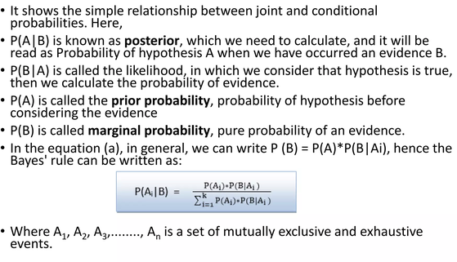

Slide 59
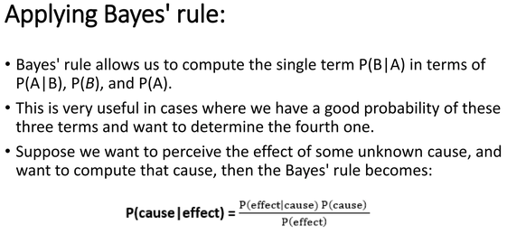

Slide 60
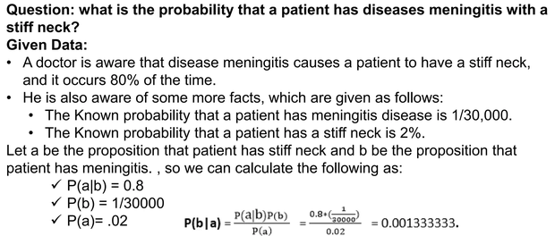

Slide 61
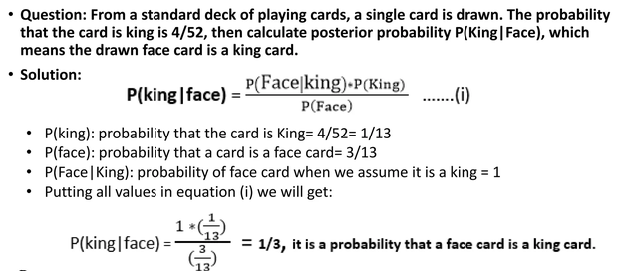

Slide 62

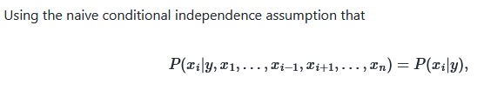
a set of supervised learning algorithms
  based on applying Bayes’ theorem with
  the “naive” assumption of conditional independence between every pair of features given the value of the class variable.

Slide 63
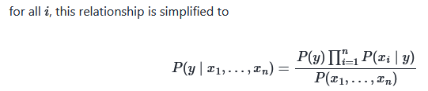
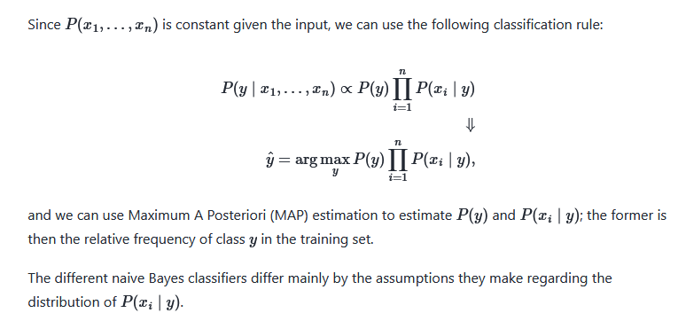

Slide 64
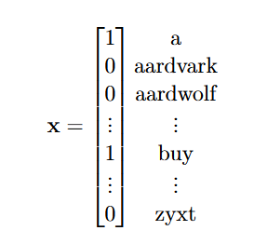
Naıve Bayes
  And,
    very high dimensional problems
Example:
  Constructing a spam filter. Each example is an email, each dimension
  “j” of vector x represents the presence of a word.
  This x represents an email containing the words “a” and “buy”, but not “aard-
  vark” or “zyxt”. The size of the vocabulary could be ∼50,000 words, so we are
  in a 50,000 dimensional space.

Slide 65
Gaussian Naive Bayes
  Gaussian Naive Bayes is a simple probabilistic classification algorithm that applies Bayes' Theorem to continuous data by assuming that the features follow a normal (Gaussian) distribution
  Feature Independence: It assumes that every feature is completely independent of any other feature given the class label (the "naive" assumption).
  Gaussian Distribution: It assumes that the continuous values associated with each class are distributed according to a normal bell-shaped curve. [1, 2]
  Calculate Priors: It computes the prior probability of each class (P(y)) by finding its relative frequency in the training data. [1, 2]
  Compute Statistics: During training, it calculates the mean (μ) and variance (σ²) for each individual feature within each distinct class. [1, 2]
  Evaluate Likelihood: For a new data point, it uses the Gaussian Probability Density Function (PDF) and the learned means and variances to calculate how likely that feature value is for each class. [1, 2, 3]
  Predict Class: It multiplies the prior probability by the likelihoods of all features for each class and assigns the data point to the class with the highest resulting posterior probability. [1]

Slide 66

Common Applications
  Spam Filtering: Categorizing incoming messages as spam or not spam based on continuous feature metrics.
  Medical Diagnosis: Predicting disease presence using continuous clinical measurements like blood pressure, age, or test results.
  Anomaly Detection: Flagging fraudulent bank transactions or unusual network activity.

Slide 67
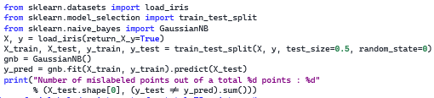

Slide 68
Multinomial Naive Bayes
  Multinomial Naive Bayes is a probabilistic machine learning algorithm designed for discrete data, primarily used in text classification tasks. It is a specialized variant of the broader Naive Bayes family that models the probability of data based on a multinomial distribution, which makes it exceptionally well-suited for features that represent counts or frequencies (such as word counts in a document).

Slide 69
Bernoulli Naive Bayes
  Bernoulli Naive Bayes is a specialized probabilistic classification algorithm based on Bayes' theorem that operates on binary or boolean features (0 or 1, true or false)
How It Works
  Binary Features: It evaluates the presence (1) or absence (0) of a feature rather than its frequency or continuous value.
  Explicit Absence Modeling: Unlike Multinomial Naive Bayes (which ignores words that do not appear), Bernoulli Naive Bayes actively computes and penalizes the non-occurrence of a feature.
  Independence Assumption: It assumes that all features are conditionally independent given the class label.

Slide 70
Common Use Cases
  Spam Filtering: Determining if specific trigger words appear in an email.
  Sentiment Analysis: Classifying short text reviews based on indicator words.
  Document Classification: Handling short text fragments or binary bag-of-models efficiently.

Slide 71
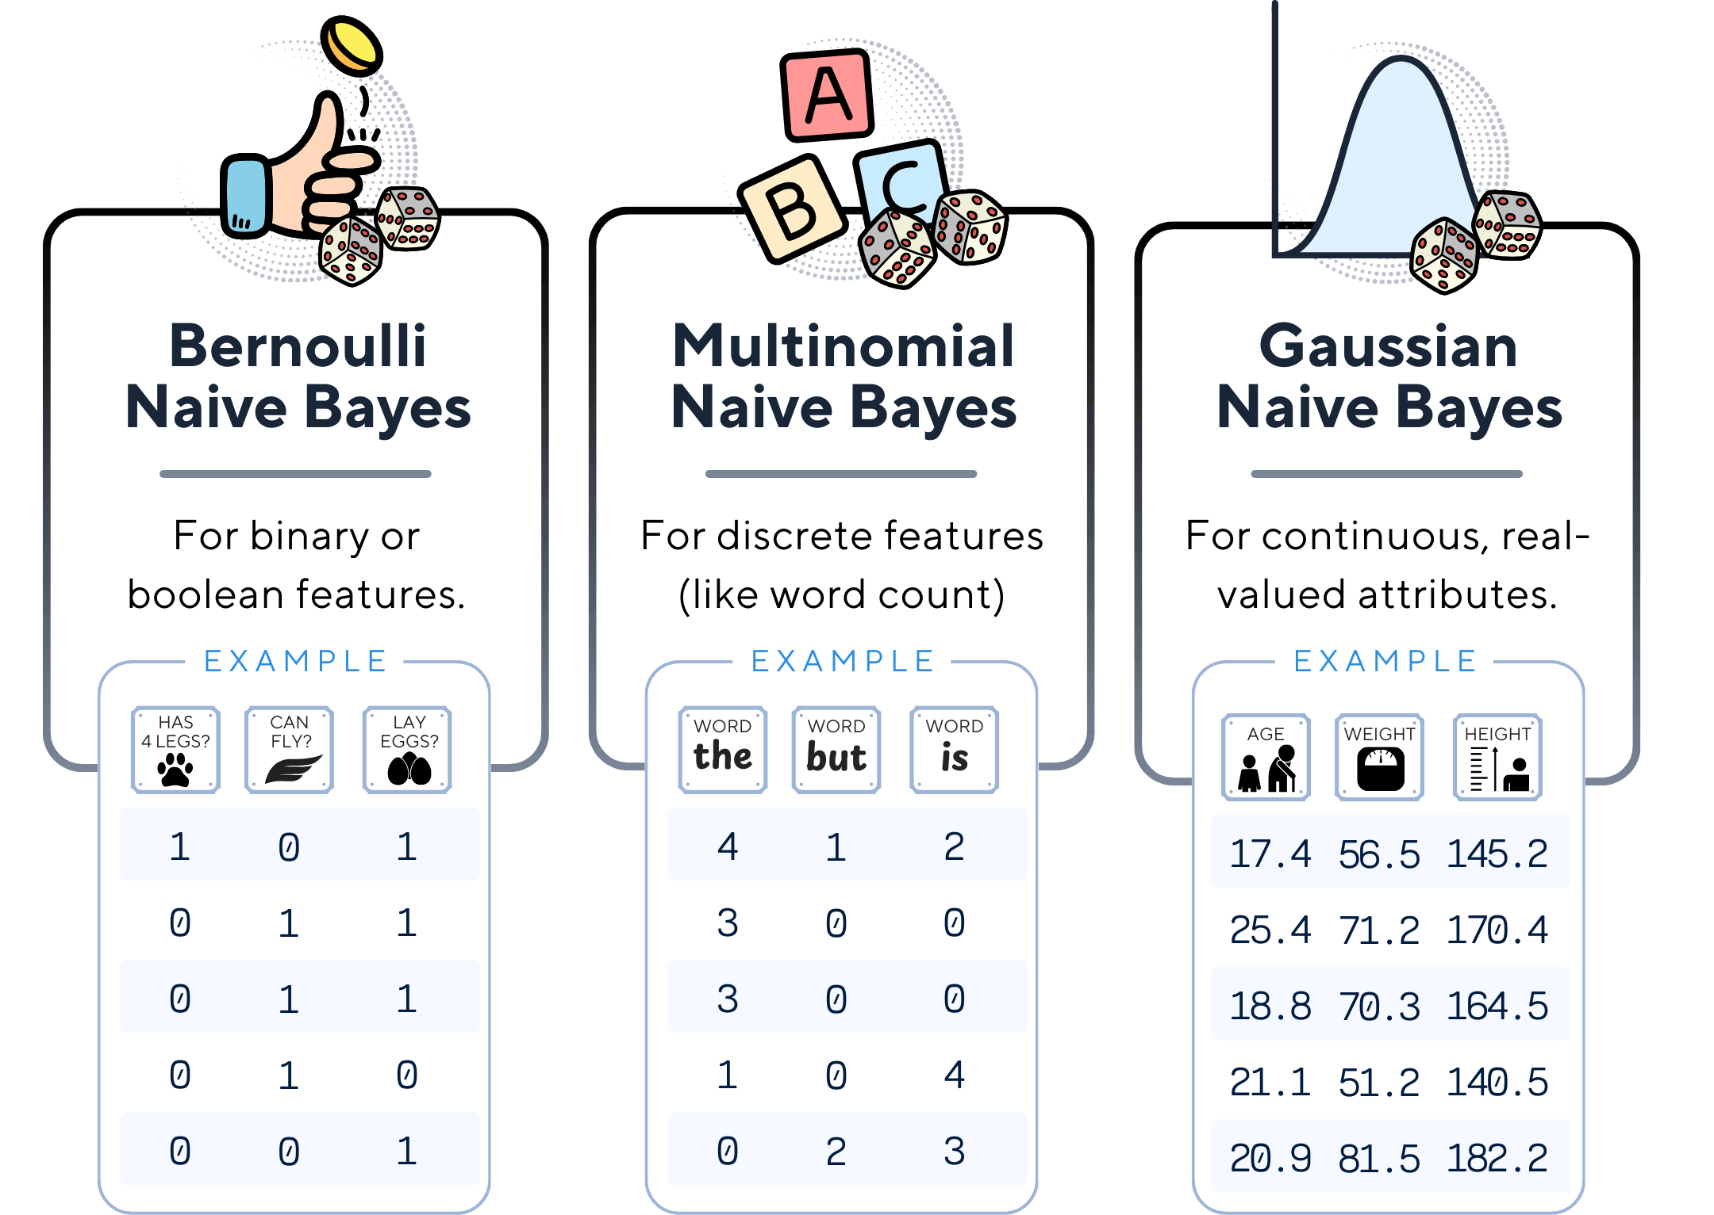

Slide 72

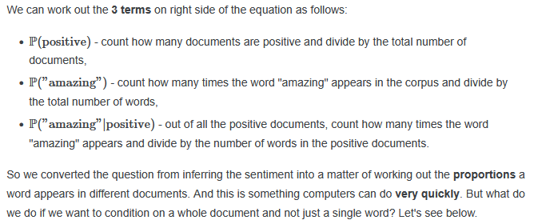
Text classification
  Conditioning on a word
    Suppose we want to classify a piece of text as being either positive or negative sentiment. If the word "amazing" appears, what is the probability that that document is positive? Let's use Bayes' theorem.

Slide 73
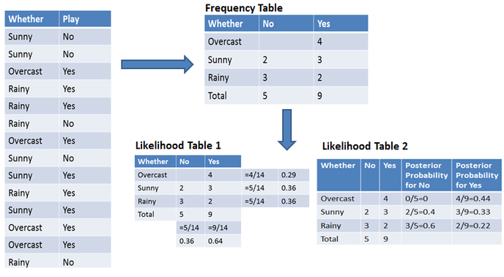
an example
  of weather conditions and playing sports.

Slide 74
Now, suppose you want to calculate the probability of playing when the weather is overcast.
  Probability of playing:
  P(Yes | Overcast) = P(Overcast | Yes) × P(Yes) / P(Overcast)
  Step 1: Calculate Prior Probabilities
    P(Overcast) = 4/14 = 0.29
    P(Yes) = 9/14 = 0.64
  Step 2: Calculate posterior probability
    P(Overcast | Yes) = 4/9 = 0.44
  Step 3: Apply Bayes Formula
    Here, we put the prior and posterior probabilities into the first equation.
    P(Yes | Overcast) = 0.44 × 0.64 / 0.29 = 0.98
  Similarly, you can calculate the probability of not playing:
  Probability of not playing:
    P(No | Overcast) = P(Overcast | No) × P(No) / P(Overcast)

Slide 75
Similarly, you can calculate the probability of not playing:
  Probability of not playing:
    P(No | Overcast) = P(Overcast | No) × P(No) / P(Overcast)
    Step 1: Calculate prior probabilities
      P(Overcast) = 4/14 = 0.29
      P(No) = 5/14 = 0.36
    Step 2: Calculate likelihood
      P(Overcast | No) = 0/5 = 0
    Step 3: Apply Bayes Formula
      Here, we put the prior and likelihood probabilities into the equation to get the posterior probability.
      P(No | Overcast) = 0 × 0.36 / 0.29 = 0
    The probability of a 'Yes' class is higher. So you can determine here if the weather is overcast, then players will play the sport.

Slide 76
Naive Bayes Advantages
  It is not only a simple approach but also a fast and accurate method for prediction.
  Naive Bayes has a very low computation cost.
  It can efficiently work on a large dataset.
  It performs well in case of discrete response variable compared to the continuous variable.
  It can be used with multiple class prediction problems.
  It also performs well in the case of text analytics problems.
  When the assumption of independence holds, a Naive Bayes classifier performs better compared to other models like logistic regression.
Naive Bayes Disadvantages
  The assumption of independent features. In practice, it is almost impossible that model will get a set of predictors which are entirely independent.
  If there is no training tuple of a particular class, this causes zero posterior probability. In this case, the model is unable to make predictions. This problem is known as Zero Probability/Frequency Problem.

